Slide 1
Object Oriented Programming—C++ Lecture10 Advanced Topics(2)
Qijun Zhao
College of Computer Science
Sichuan University
Spring 2025

Slide 2
Recoverable Error Handing
Recoverable Conditions that are not under the control of the program. They indicate
“exceptional” run-time conditions. e.g. file not found, bad allocation, wrong user input, etc.
The common ways for handling recoverable errors are:
Exceptions Robust but slower and requires more resources
Error values Fast but difficult to handle in complex programs

Slide 3
C++ Exceptions - Advantages
C++ Exceptions provide a well-defined mechanism to detect errors passing the
information up the call stack
• Exceptions cannot be ignored. Unhandled exceptions stop program execution
(call std::terminate() )
• Intermediate functions are not forced to handle them. They don’t have to
coordinate with other layers and, for this reason, they provide good composability
• Throwing an exception acts like a return statement destroying all objects in the
current scope
• An exception enables a clean separation between the code that detects the error
and the code that handles the error
• Exceptions work well with object-oriented semantic (constructor)

Slide 4
C++ Exceptions - Disadvantages
• Code readability: Using exception can involve more code than the functionality
itself
• Code comprehension: Exception control flow is invisible and it is not explicit in
the function signature
• Performance: Extreme performance overhead in the failure case (violate the
zero-overhead principle)
• Dynamic behavior: throw requires dynamic allocation and catch requires
RTTI. It is not suited for real-time, safety-critical, or embedded systems
• Code bloat: Exceptions could increase executable size by 5-15%

Slide 5
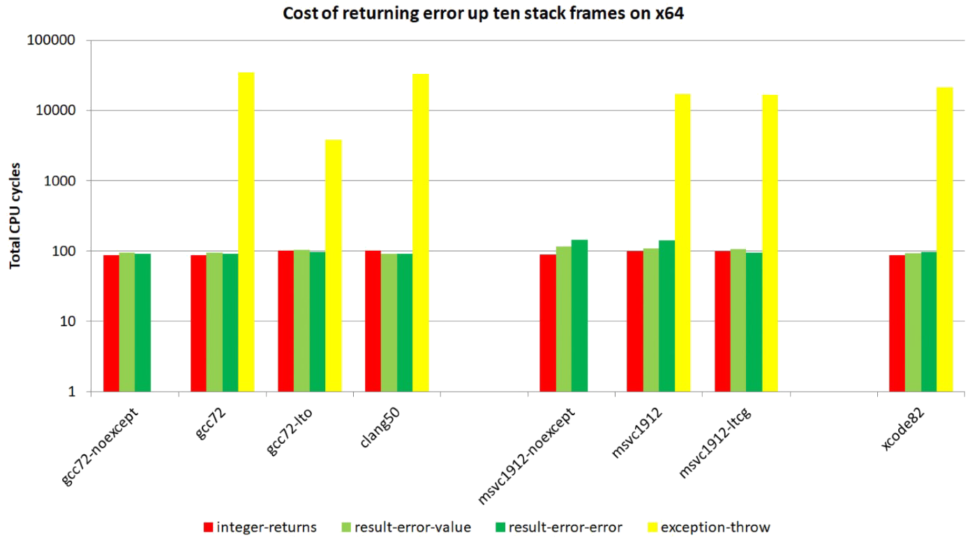
C++ Exceptions - Disadvantages

Slide 6
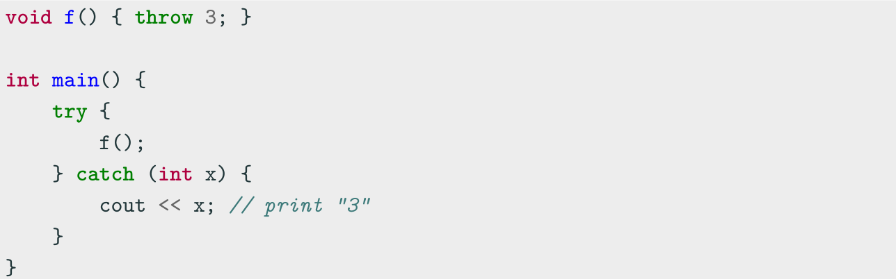
C++ Exception Basics
C++ provides three keywords for exception handling:
throw Throws an exception
try Code block containing potential throwing expressions
catch Code block for handling the exception

Slide 7
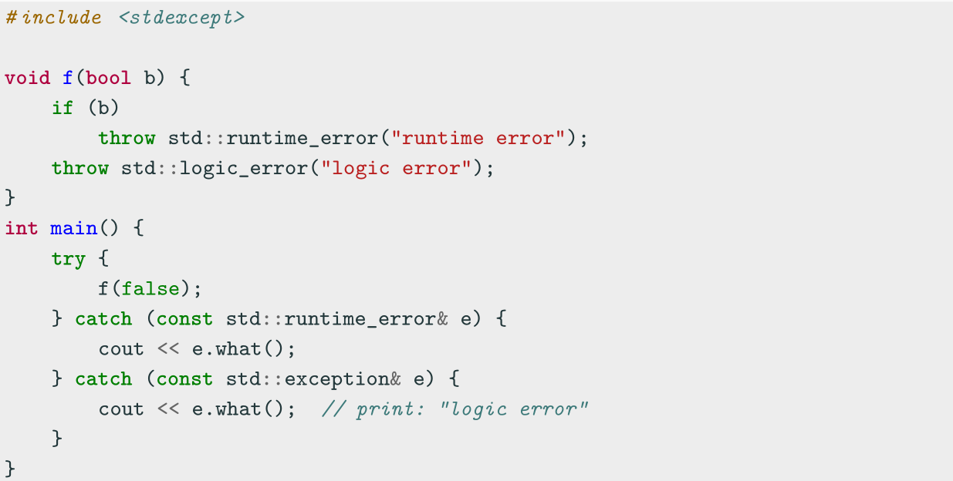
std Exceptions
throw can throw everything such as integers, pointers, objects, etc. The standard
way consists in using the std library exceptions <stdexcept>

Slide 8
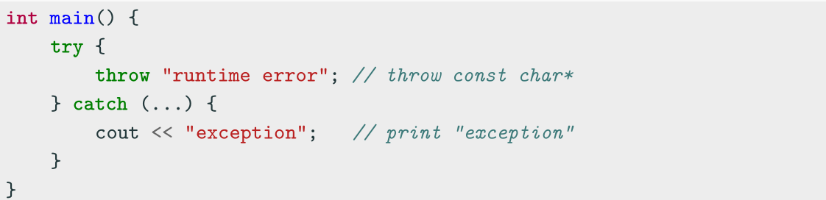
Exception Capture
NOTE: C++, differently from other programming languages, does not require explicit
dynamic allocation with the keyword new for throwing an exception. The compiler
implicitly generates the appropriate code to construct and clean up the exception
object. Dynamically allocated objects require a delete call
The right way to capture an exception is by const -reference. Capturing by-value is
also possible but, it involves useless copy for non-trivial exception objects
catch(...) can be used to capture any thrown exception

Slide 9
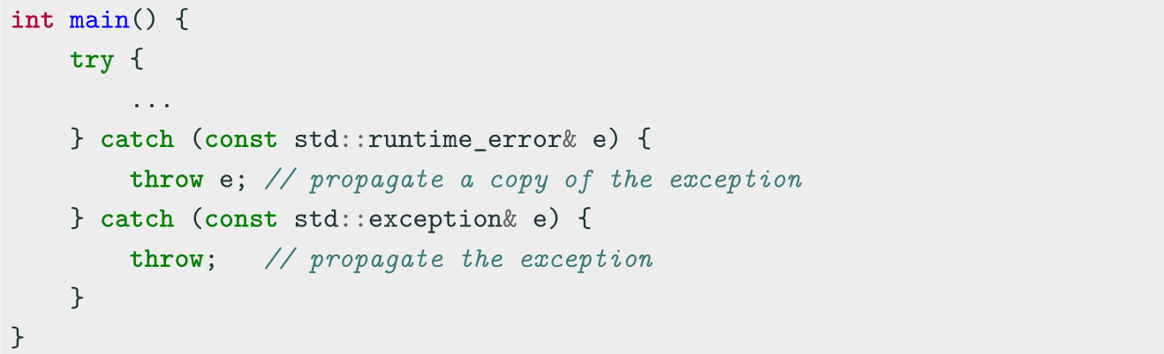
Exception Propagation
Exceptions are automatically propagated along the call stack. The user can also
control how they are propagated

Slide 10
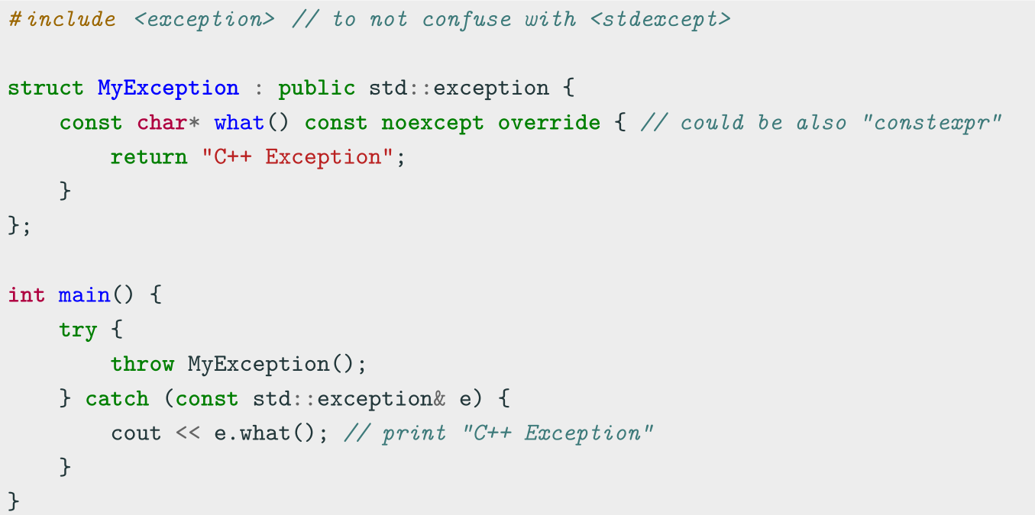
Defining Custom Exceptions

Slide 11
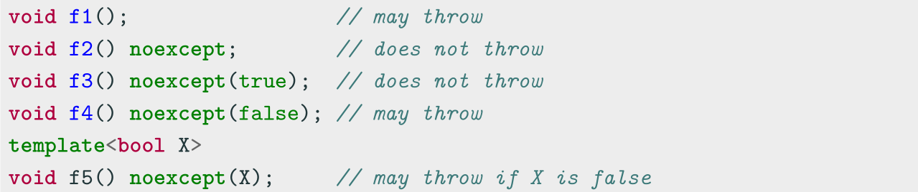
noexcept Keyword
C++03 allows listing the exceptions that a function might directly or indirectly throw,
e.g. void f() throw(int, const char*) {
C++11 deprecates throw and introduces the noexcept keyword
If a noexcept function throw an exception, the runtime calls std::terminate()
noexcept should be used when throwing an exception is impossible or unacceptable.
It is also useful when the function contains code outside user control, e.g. std
functions/objects

Slide 12
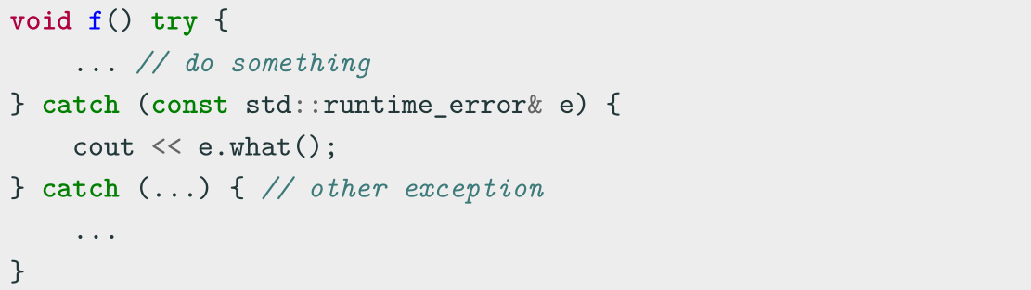
Function-try-block
Exception handlers can be defined around the body of a function

Slide 13
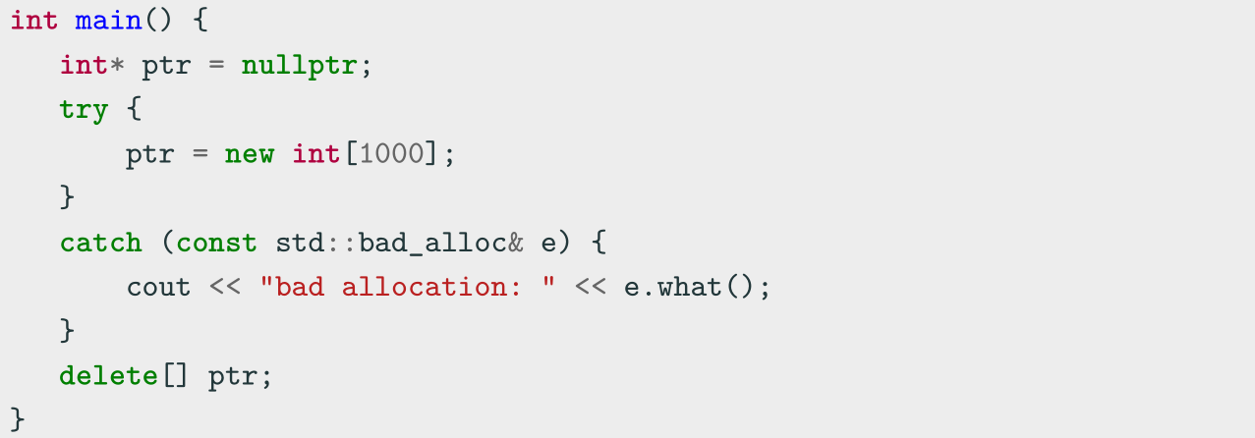
Memory Allocation Issues
The new operator automatically throws an exception ( std::bad_alloc ) if it cannot
allocate the memory
delete never throws an exception (unrecoverable error)

Slide 14
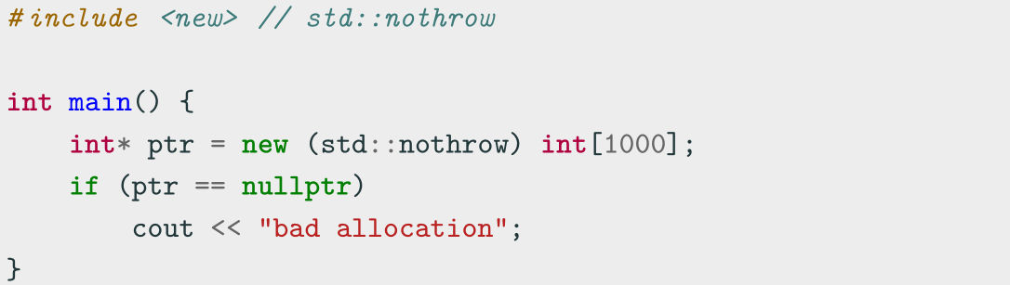
Memory Allocation Issues
C++ also provides an overload of the new operator with non-throwing memory
allocation

Slide 15
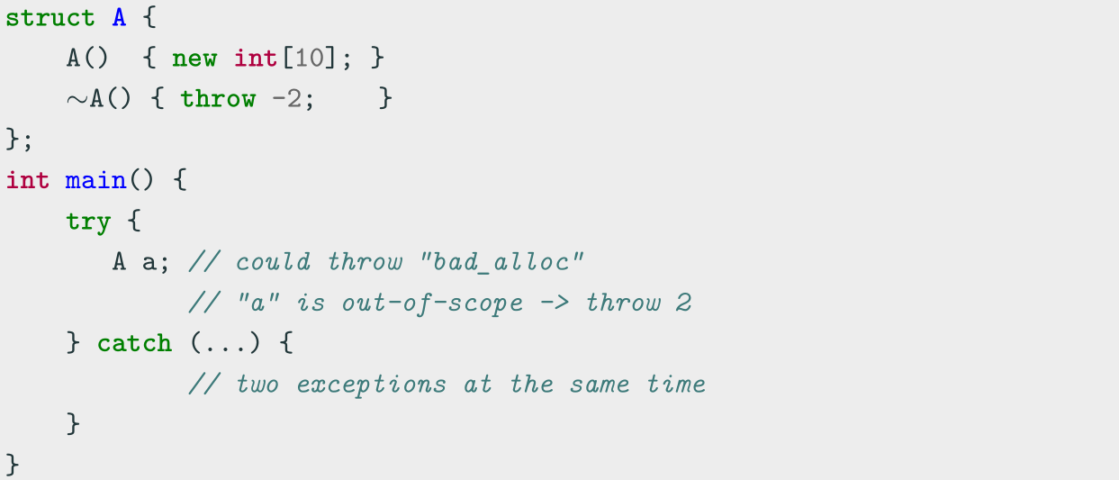
Memory Allocation Issues
Throwing exceptions in constructors is fine while it is not allowed in destructors
Destructors should be marked noexcept

Slide 16
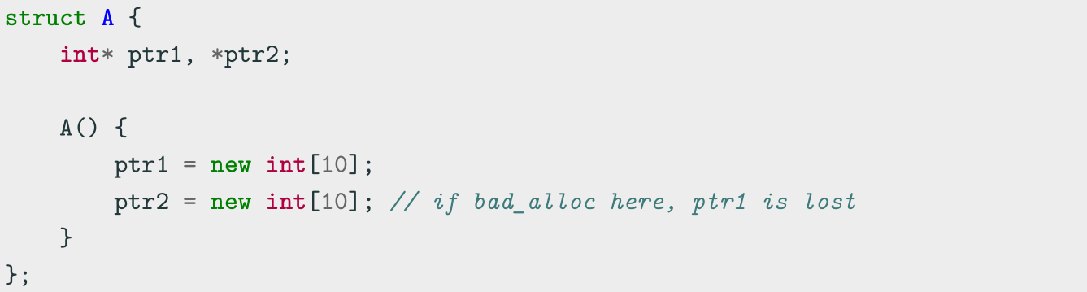
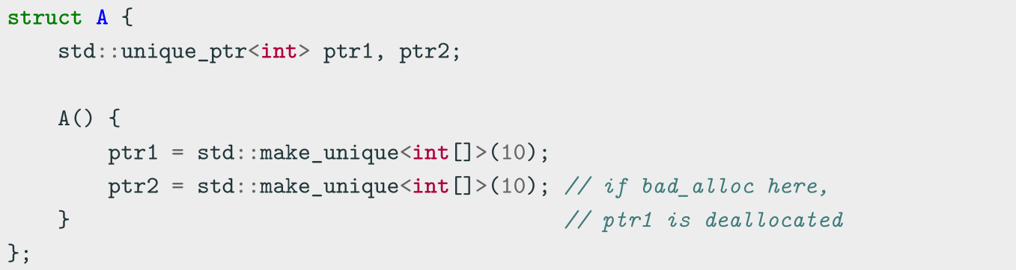
Memory Allocation Issues

Slide 17
Alternative Error Handling Approaches
• Global state, e.g. errno
- Easily forget to check for failures
- Error propagation using if statements and early return is manual
- No compiler optimizations due to global state
• Simple error code, e.g. int , enum , etc.
- Easily forget to check for failures (workaround [[nodiscard]] )
- Error propagation using if statements and early return is manual
- Potential error propagation through different contexts and losing initial error
information
- Constructor errors cannot be handled

Slide 18
Alternative Error Handling Approaches
• std::error code , standardized error code
- Easily forget to check for failures (workaround [[nodiscard]] )
- Error propagation using if statements and early return is manual
- Code bloating for adding new enumerators (see Your own error code)
- Constructor errors cannot be handled
• Supporting libraries, e.g. Boost Outcome, STX, etc.
- Require external dependencies
- Constructor errors cannot be handled in a direct way
- Extra logic for managing return values

Slide 19
Undefined Behavior Overview
Undefined behavior means that the semantic of certain operations is
• Unspecified behavior: outside the language/library specification, two or more choices
• Illegal: the compiler presumes that such operations never happen, e.g. integer overflow
• Implementation-defined behavior: depends on the compiler and/or platform (not portable)
Motivations behind undefined behavior:
• Compiler optimizations, e.g. signed overflow or NULL pointer dereferencing
• Simplify compile checks
• Unfeasible/expensive to check

Slide 20
Illegal Behavior
Some Examples:
• const_cast applied to a const variables
• Memory alignment: using int* to point to an address in char array
• Missing return statement in a non-void function.
• Memory access-related: Out-of-bound access: the code could crash or not depending on the platform/compiler

Slide 21
Platform Specific Behavior
Some Examples:
• Memory access-related: NULL pointer dereferencing: the 0x0 address is valid in some platforms
• Endianness
• Type definition: long x = 1ul << 32u
• Memory access-related: Out-of-bound access: the code could crash or not depending on the platform/compiler
Notes:
Endianness 字节顺序

Slide 22
Unspecified Behavior
Legal operations but the C++ standard does not document the result → different compilers/platforms can show different behavior
• Signed shift of negative values -2 ≪ x (before C++20), large-than-type shift 3u ≪ 32 , etc.
• Floating-point narrowing conversion between floating-point types with unrepresentable values double → float
• Arithmetic operation ordering f(i++, I++)
• Function evaluation ordering: auto x = f() + g();
• Signed overflow

Slide 23
Detecting Undefined Behavior
There are several ways to detect or prevent undefined behavior at compile-time and at run-time:
• Using undefined behavior sanitizer, see Debugging and Testing: Sanitizer
• Static analysis tools
• constexpr expressions doesn’t allow undefined behavior

Slide 24
Coding to make the world better
Qijun Zhao
qjzhao@scu.edu.cn

